Slide 1
Predict Types of Mental Disorders & Substance Dependence Using Machine Learning Method
Evan Qian | 04/24/2023

Slide 2
Problem Definition/Formulation
The prediction of mental disorders and substance dependence types is a crucial and challenging task in the field of psychiatry and mental health.
Early and accurate identification of these conditions can help healthcare professionals provide timely and targeted treatment, ultimately improving patient outcomes.
Objective: develop a machine learning-based model that can accurately predict the types of mental disorders and substance dependence by analyzing various features extracted from patient data.
Notes:
Mental health and substance dependence are significant issues worldwide, and early identification of these conditions can greatly impact treatment outcomes. Machine learning can be a valuable tool in this regard, providing clinicians and researchers with insights to faster understand and diagnose these disorders.

Slide 3
Data Preprocessing
Data: Treatment Episode Dataset Discharge (TEDS-D) datasets from the U.S. Substance Abuse and Mental Health Services Administration (SAMHSA) from 2018 to 2020
TEDS-D includes all admissions/discharges rather than individuals.
Include only records that indicate the individual had no prior SUD treatment
It is known that racial and ethnic minorities vary in their treatment access and success levels → Restrict analysis on Race/Ethnicity (Asian)
Focused on outpatient service settings
DataFrame Dimension: (4780262, 76) → (8845, 76)
Rank the features using Random Forest feature importance
Notes:
Because criteria for treatment completion/success (i.e., the outcome of interest) and duration for other types of services (e.g., 24-hour inpatient, detoxification-only) and outpatient services are often very different
Split the dataset into training and testing sets, with 70% of the data used for training the models and 30% for testing their performance.
Performance metrics such as accuracy, precision, recall, and F1 score were used to evaluate and compare the performance of the models.

Slide 4
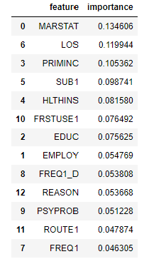
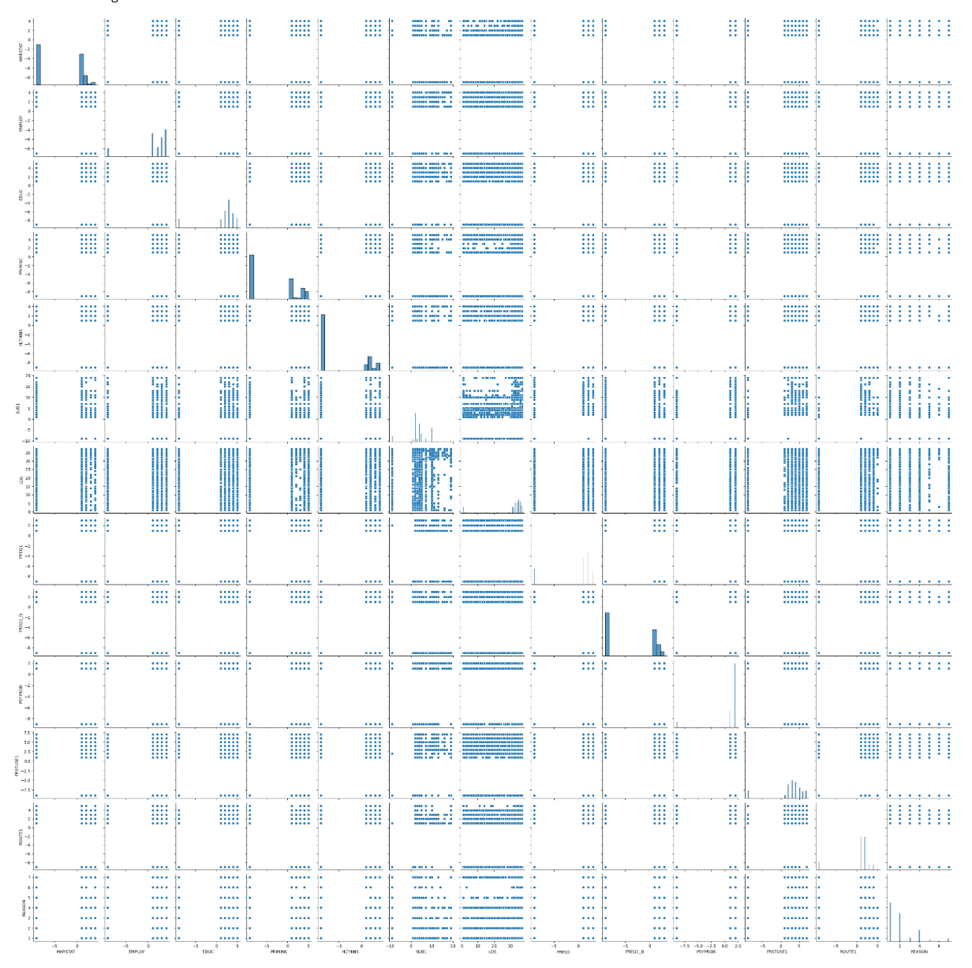
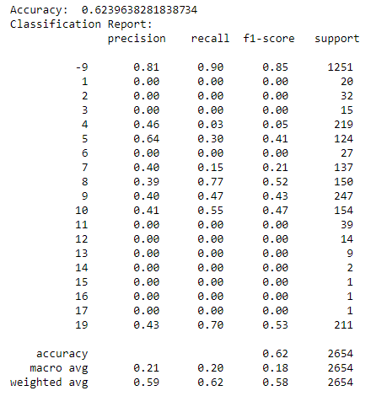
Visualization and Methodology
Model Used:
Random Forest
Logistic Regression
Deep Learning ANN
Results:
RF: Multi-class AUC→ 0.9109
LR: Multi-class AUC→ 0.8625
ANN (No Meaningful Results)
Pairplot (13 features: 5 BG + 8 MH )

Slide 5
Conclusion
Assumptions:
ANN fails: Insufficient or unbalanced data and Suboptimal hyperparameters
More patient data can improve the score of Multi-class AUC
RandomForest Classifier provide the best prediction in the project
Future Works:
Data Quality: Larger and more representative datasets from different mental conditions.
Personalized Treatment Recommendations: Expanding the scope of the model to include personalized treatment recommendations based on the predicted mental disorder/substance dependence type
Multimodal Data Integration

Slide 6
Thank you!

